Slide 1
Visual analytics - Homework 1
Francesco fortunato - 1848527

Slide 2
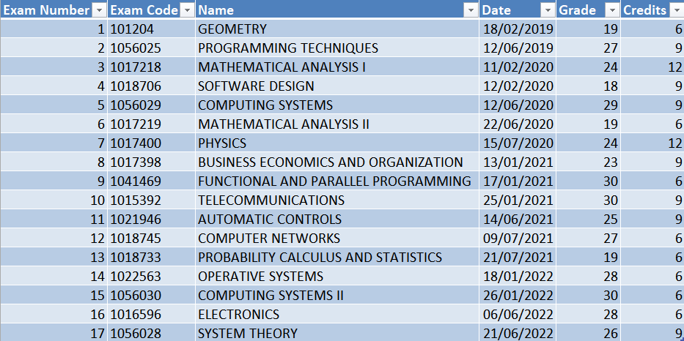
Collect all the scores of bachelor exams

Slide 3
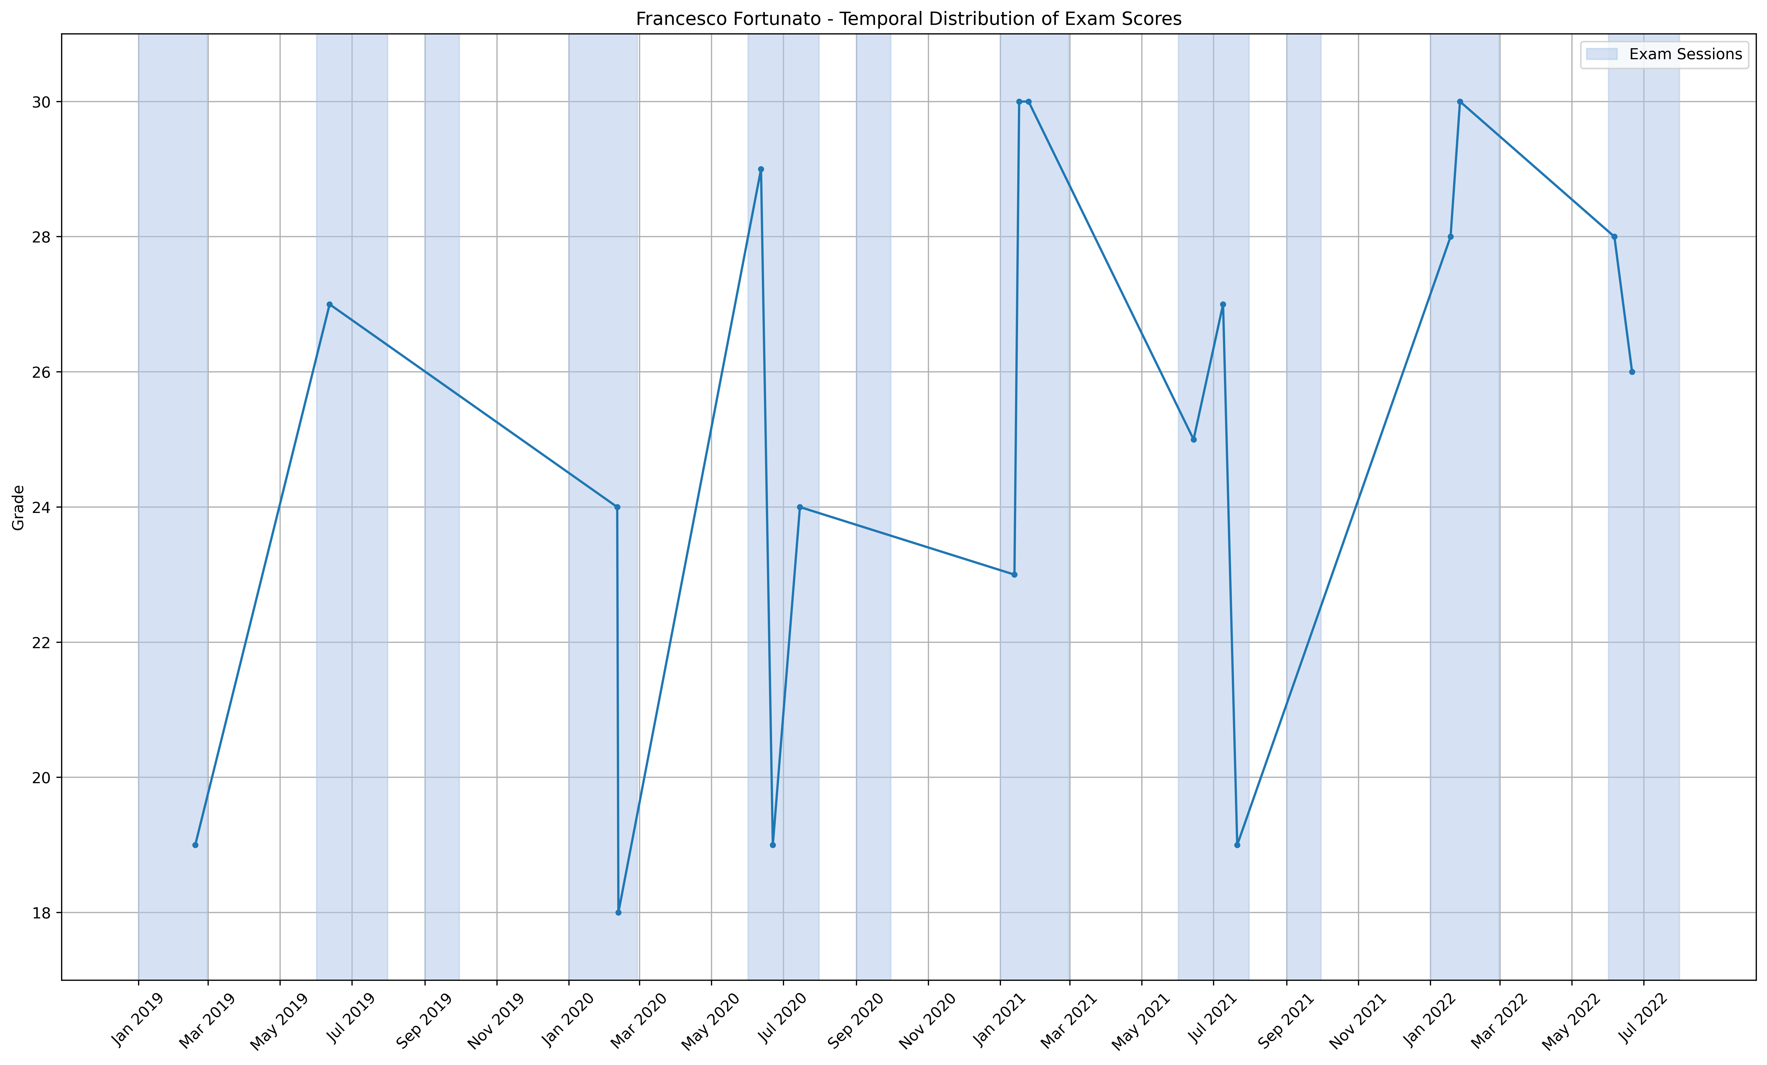
Temporal Distribution
Data Types:
- Categorical Data: 'Date' represents time, which is a categorical variable.
- Numerical Data: 'Grade' and 'Credits' are numerical variables.
Relationships:
- Categorical (Nominal): 'Date' is nominal, representing distinct points in time.
- Quantitative (Ratio): 'Grade' and 'Credits' are ratio variables as they have a true zero point (0) and support meaningful arithmetic operations.
Visual Variables/Variations:
Bar heights represent the 'Grade' numerical values.
Colors are used to distinguish different elements in the graph: bars have one color, cumulative weighted mean, cumulative simple mean, and a simple grade mean are represented by different line colors.
Line styles are used for differentiation: solid line for bar heights, dashed line for cumulative weighted mean, and dash-dot line for cumulative simple mean.

Slide 4
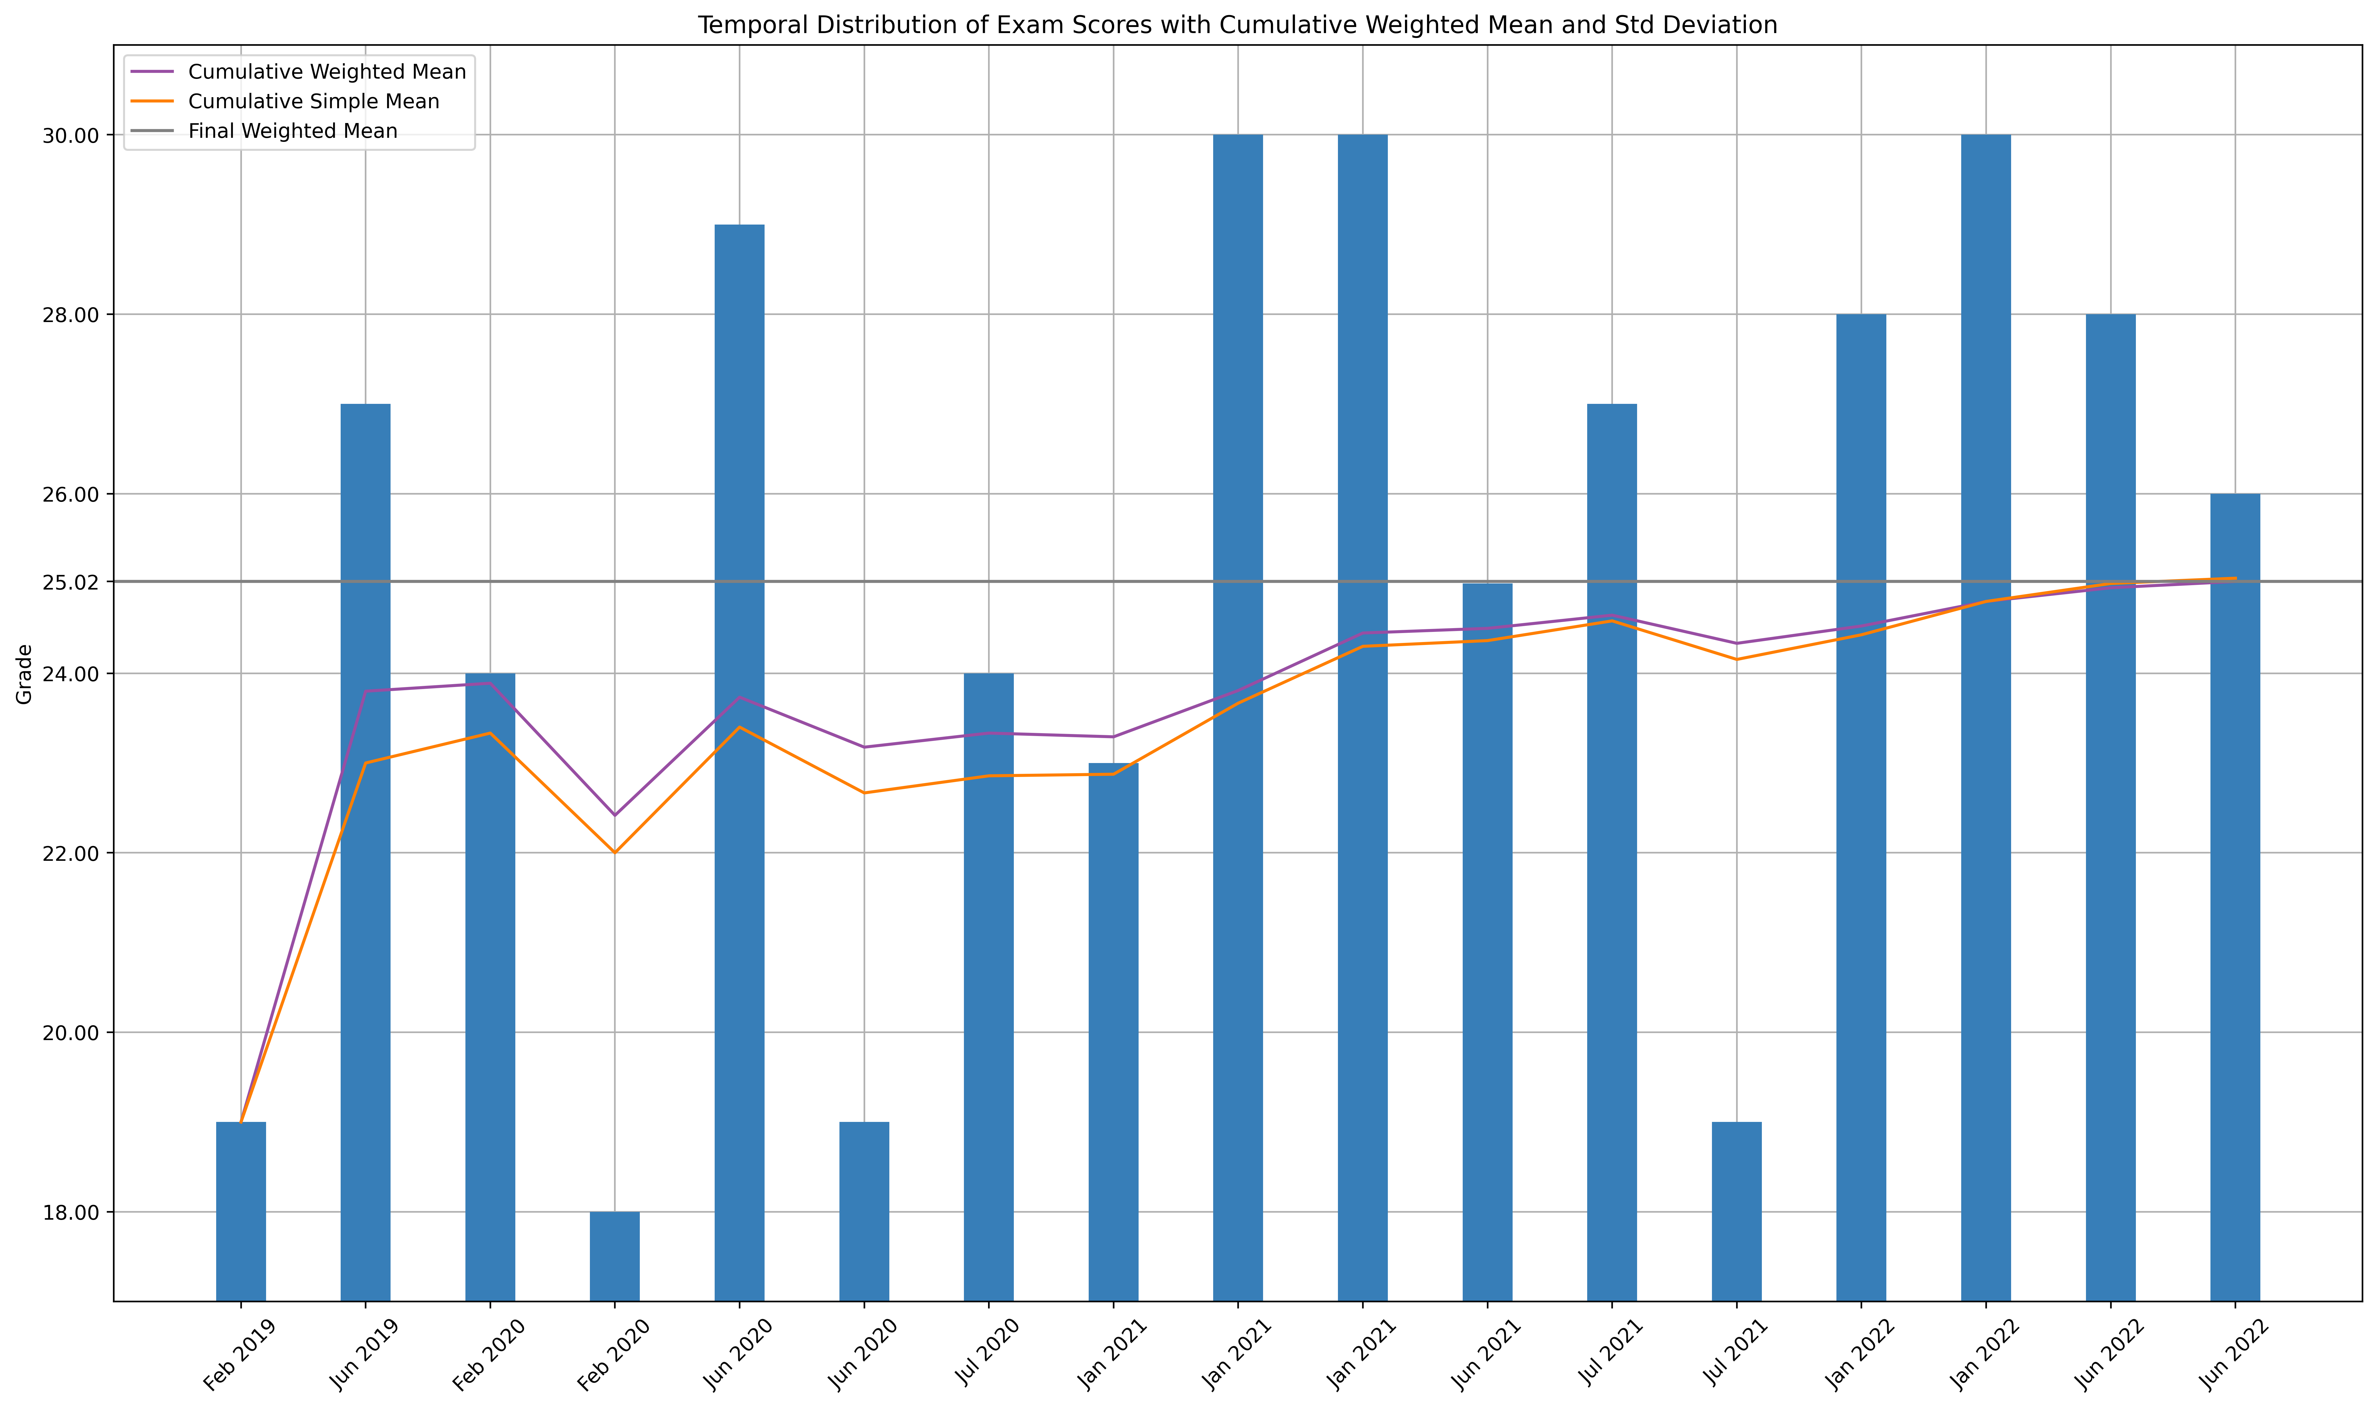
Local and global performance
Data Types:
- Categorical Data: 'Date' represents time, which is a categorical variable.
- Numerical Data: 'Grade' and 'Credits' are numerical variables.
Relationships:
- Categorical (Nominal): 'Date' is nominal, representing distinct points in time.
- Quantitative (Ratio): 'Grade' and 'Credits' are ratio variables as they have a true zero point (0) and support meaningful arithmetic operations.
Visual Variables/Variations:
Bar heights represent the 'Grade' numerical values.
Colors are used to distinguish different elements in the graph: bars have one color, cumulative weighted mean, cumulative simple mean, and a simple grade mean are represented by different line colors.
Line styles are used for differentiation: solid line for bar heights, dashed line for cumulative weighted mean, and dash-dot line for cumulative simple mean.

Slide 5
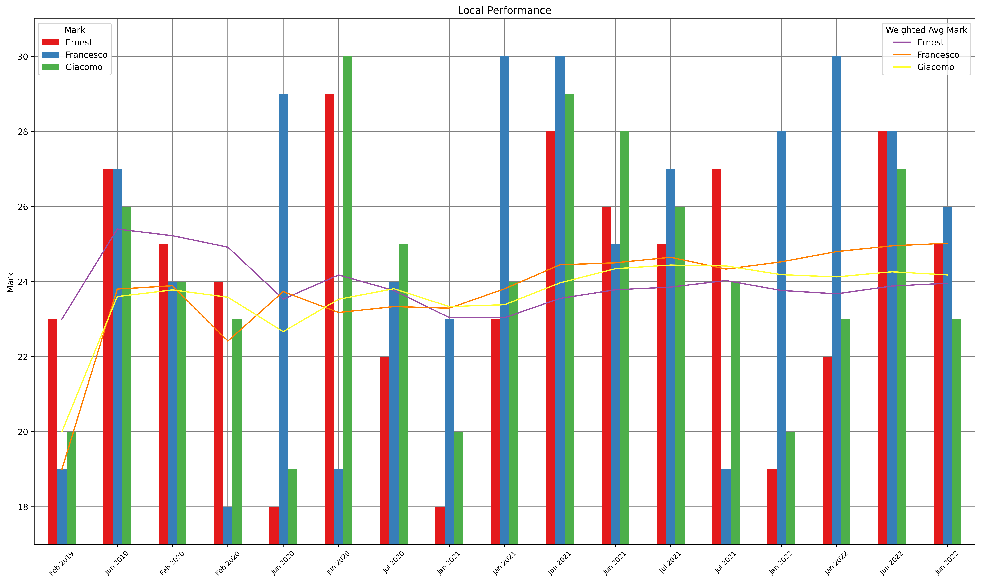
Individual Local and global performance
Data Types:
- Categorical Data: 'Date' represents time, which is a categorical variable.
- Numerical Data: 'Grade' and 'Credits' are numerical variables.
Relationships:
- Categorical (Nominal): 'Date' is nominal, representing distinct points in time.
- Quantitative (Ratio): 'Grade' and 'Credits' are ratio variables as they have a true zero point (0) and support meaningful arithmetic operations.
Visual Variables/Variations:
Bar heights represent the 'Grade' numerical values.
Colors are used to distinguish different elements in the graph: bars have one color, cumulative weighted mean, cumulative simple mean, and a simple grade mean are represented by different line colors.
Line styles are used for differentiation: solid line for bar heights, dashed line for cumulative weighted mean, and dash-dot line for cumulative simple mean.

Slide 6
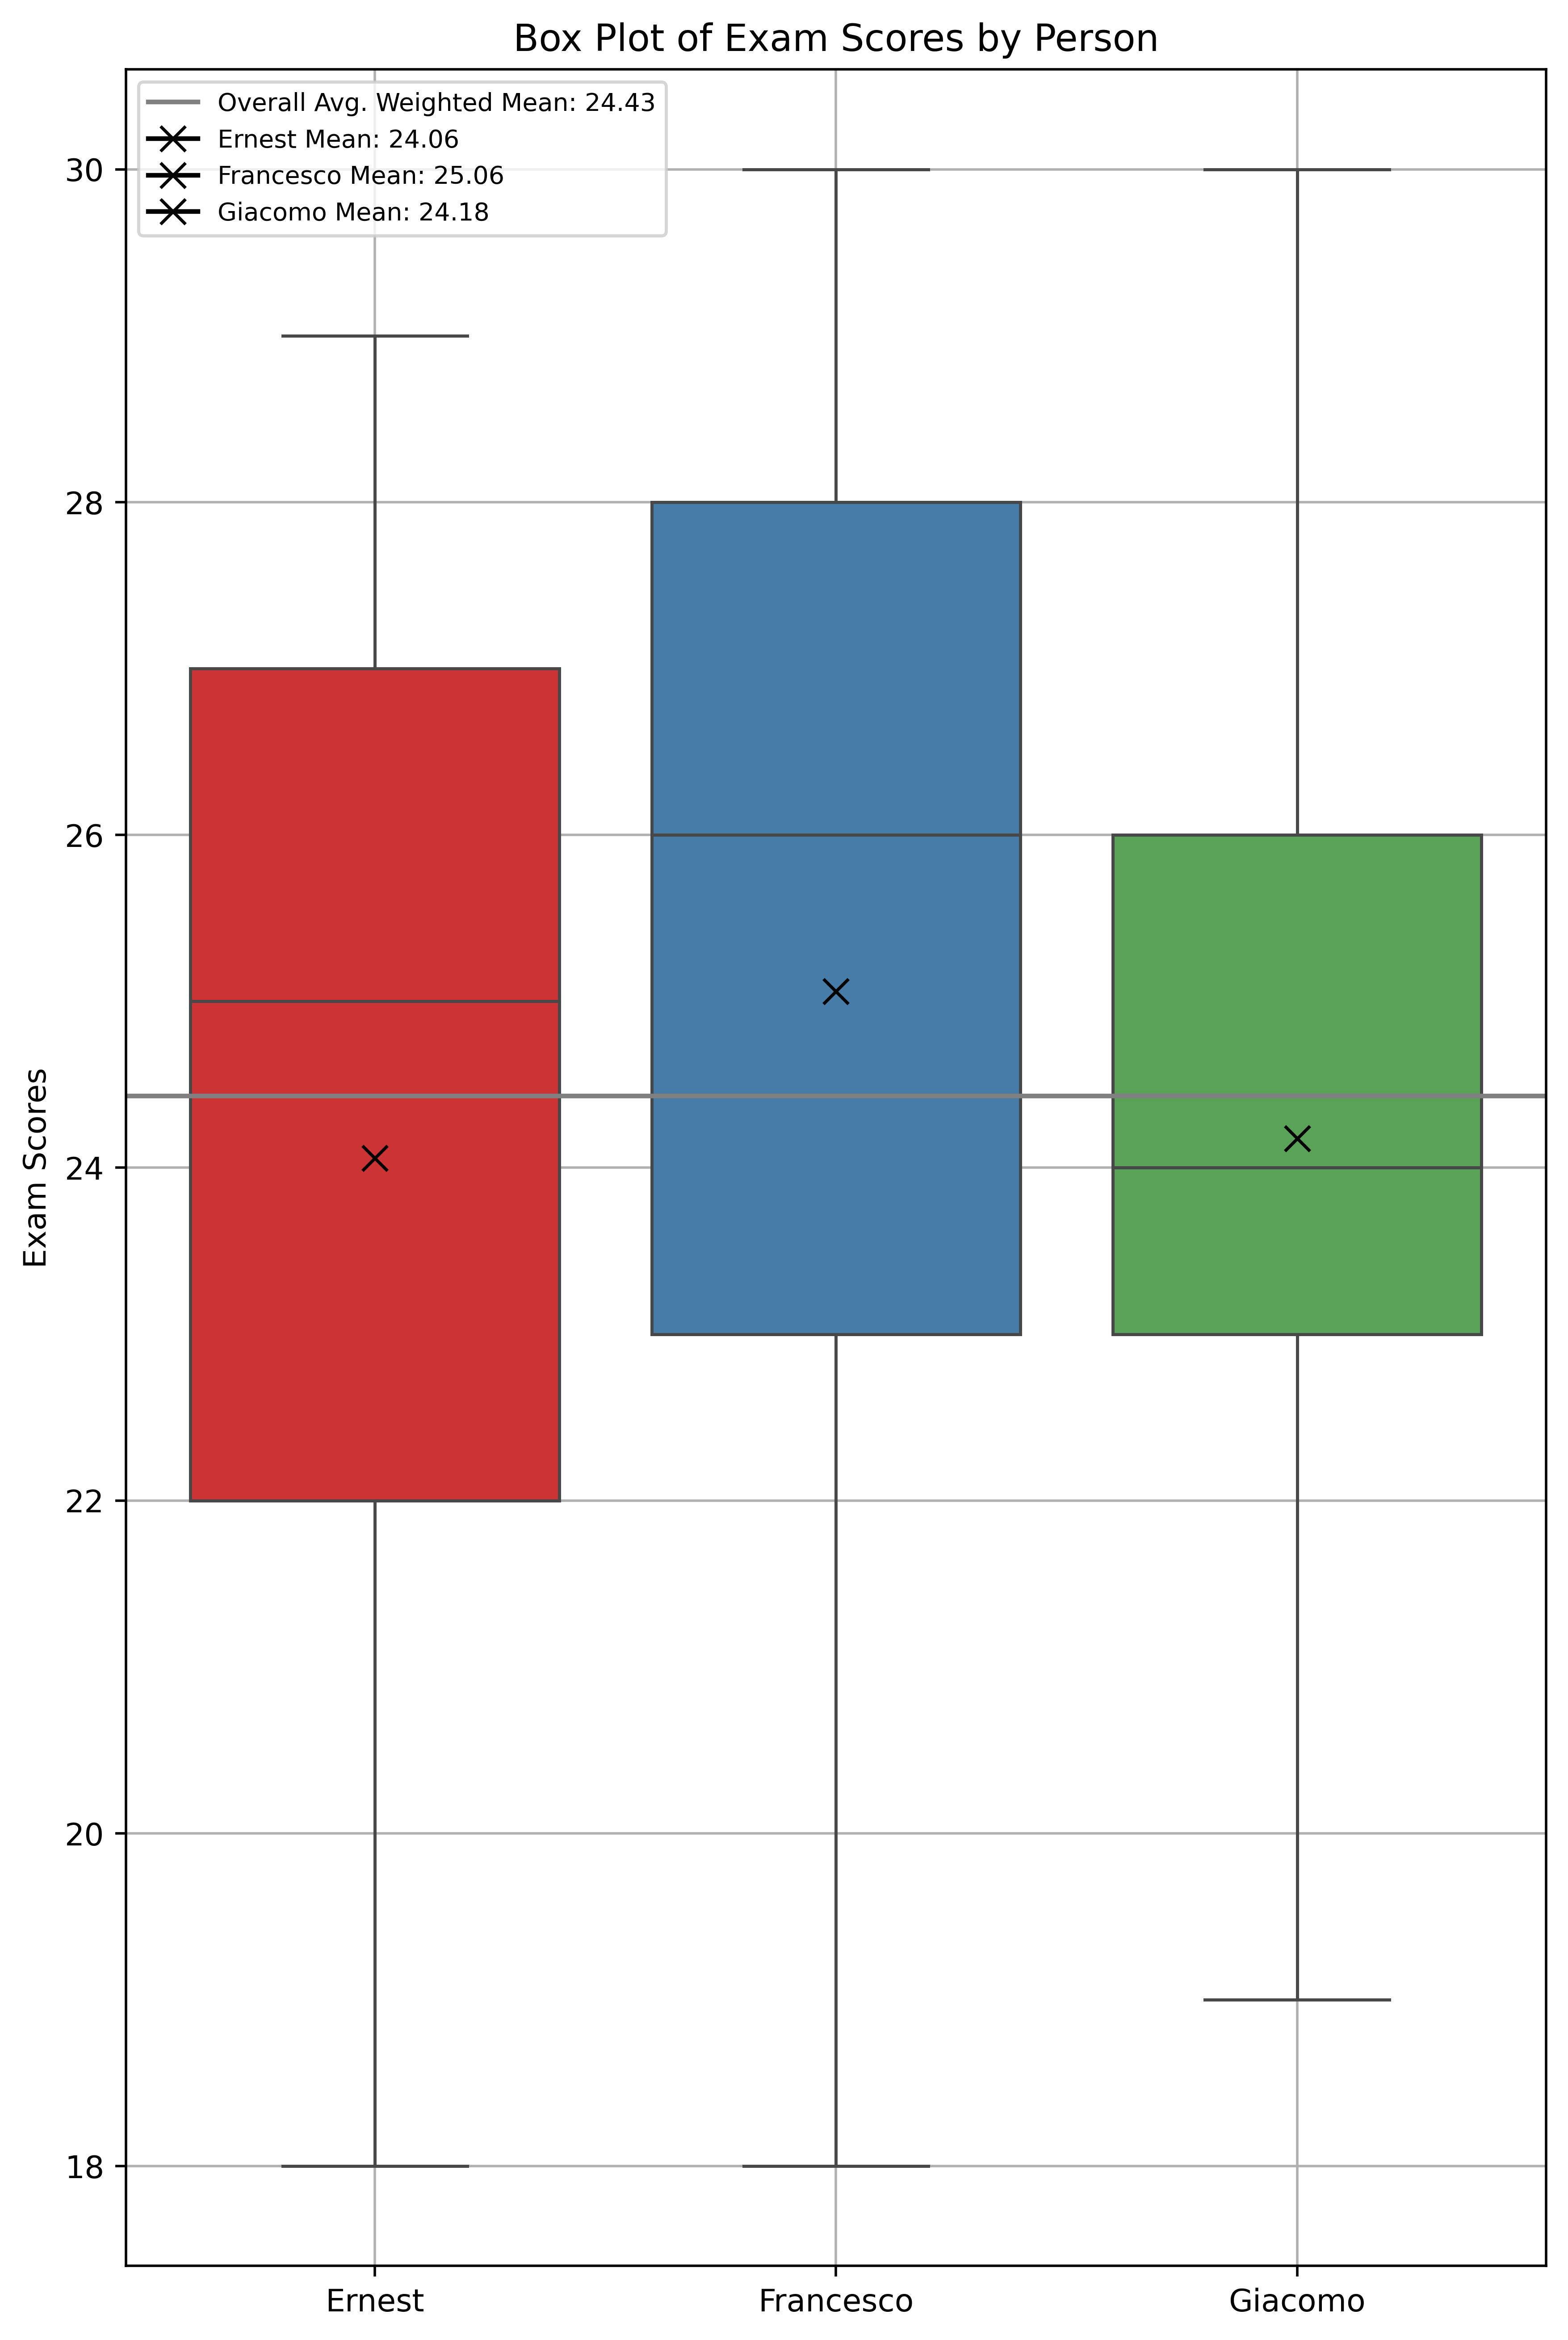
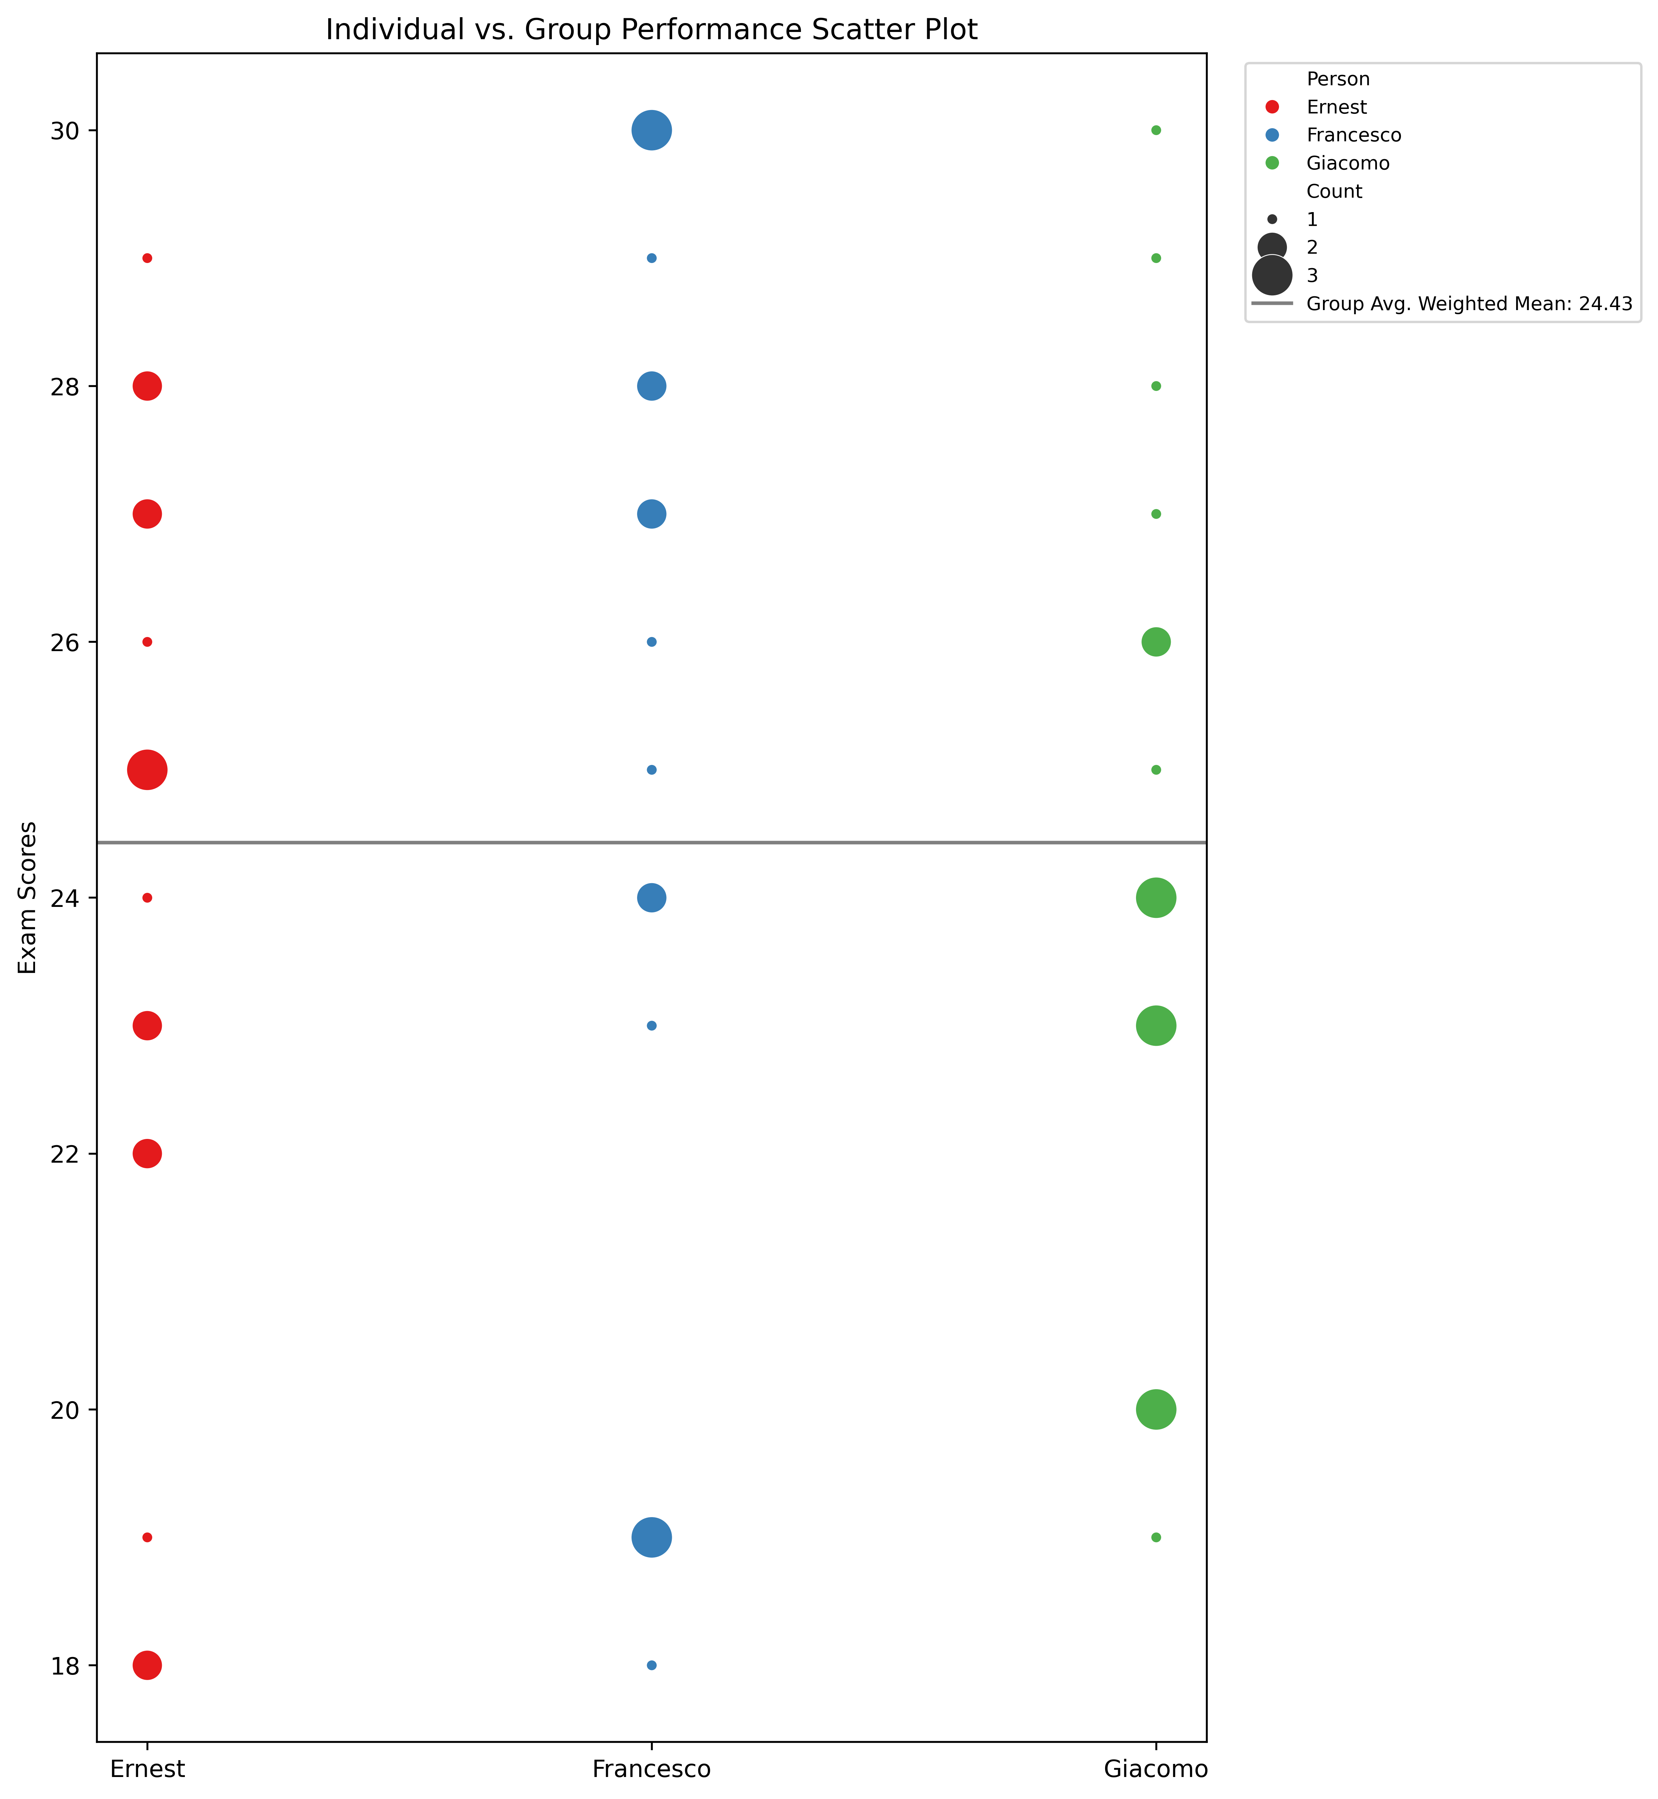
Individual and group global performance
Data Types:
- Categorical Data: 'Date' represents time, which is a categorical variable.
- Numerical Data: 'Grade' and 'Credits' are numerical variables.
Relationships:
- Categorical (Nominal): 'Date' is nominal, representing distinct points in time.
- Quantitative (Ratio): 'Grade' and 'Credits' are ratio variables as they have a true zero point (0) and support meaningful arithmetic operations.
Visual Variables/Variations:
Bar heights represent the 'Grade' numerical values.
Colors are used to distinguish different elements in the graph: bars have one color, cumulative weighted mean, cumulative simple mean, and a simple grade mean are represented by different line colors.
Line styles are used for differentiation: solid line for bar heights, dashed line for cumulative weighted mean, and dash-dot line for cumulative simple mean.

